Slide 1
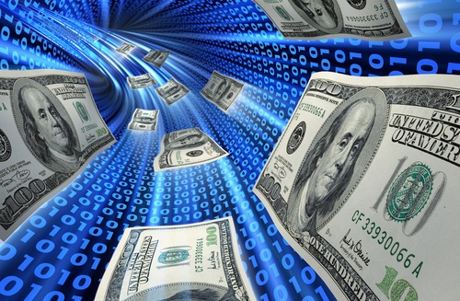
ePayment System
Team 5
Presented by: Joanna Qiu

Slide 2
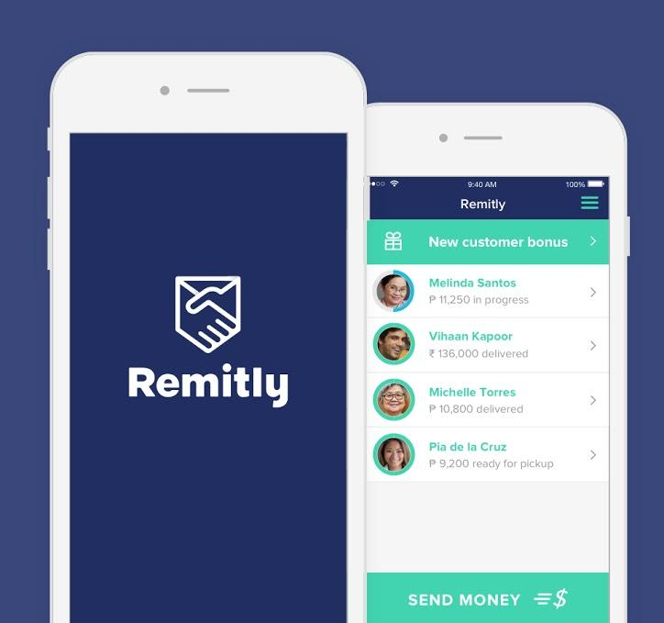
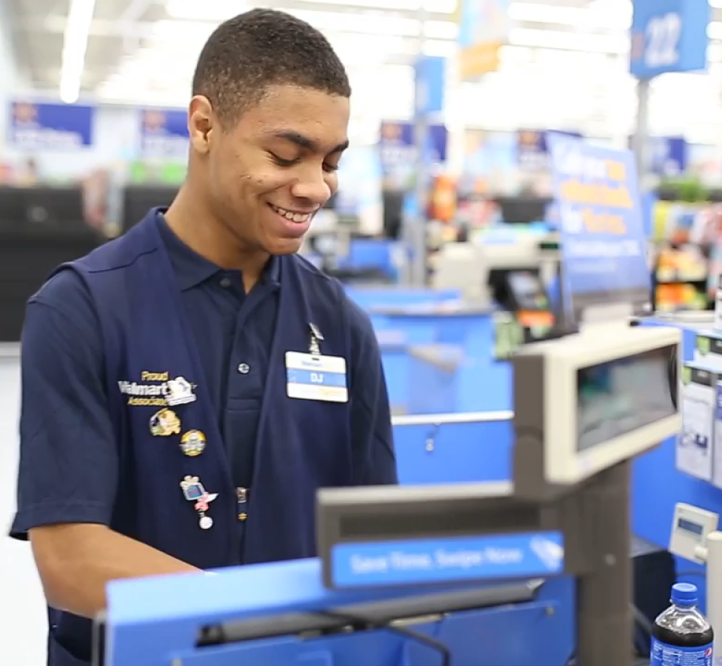

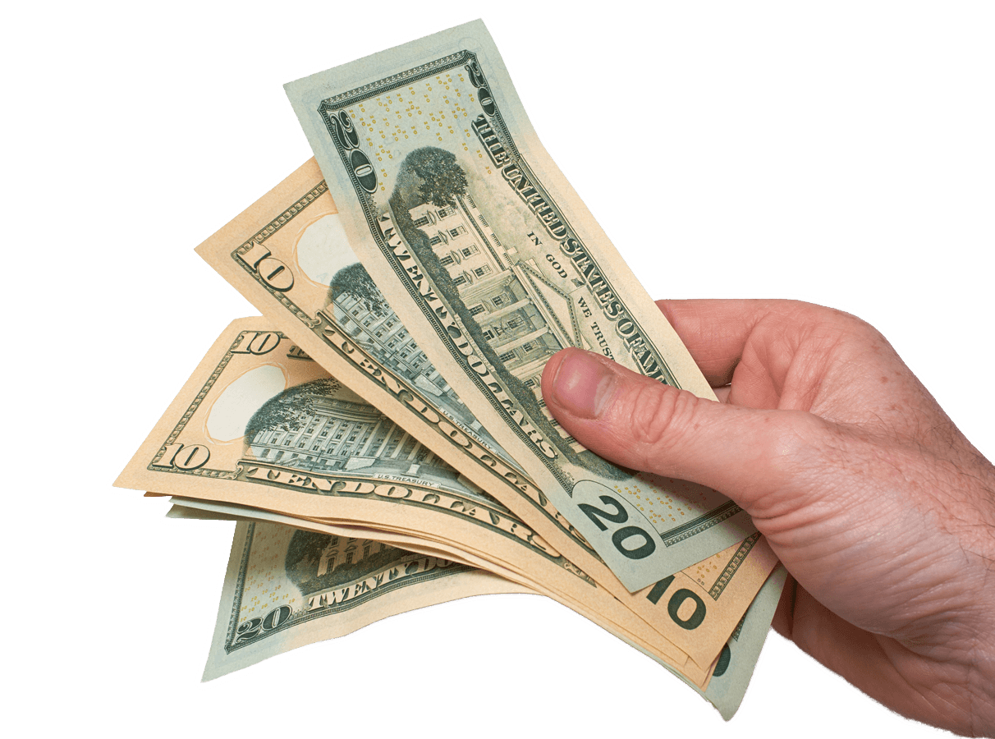
Business Need For Wal-Mart – Fraud Detection
Fraud Detection system
Detect and prevent fraud when withdrawing cash at Wal-Mart using Remitly
Increase Wal-Mart’s reliability and lessen the risk of ePayment fraud

Slide 3




Four Types of Frauds
Money Laundering
Money illegally obtained.
Make dirty money appear legal through transfers.
Impersonation
Pretending to be the sender/recipient.
Usually caused by phishing credentials or leaked bank account information.
Elder Financial Abuse
Misappropriation of elder’s financial resources by deliberately establishing a trust relationship.
Terror Financing
Financial transfers related to terrorism.

Slide 4
Fraud Detection System
Data Input from Wal-Mart and Remitly
Sender and recipient credentials, transaction details, location and devices info
Rule Based (Algorithmic) Fraud Detection Logic
Machine Learning Algorithms
Output
Average of the two algorithms, a list of probability e.g. [80%, 30%, 0%, 0%]

Slide 5
Rule Based (Algorithmic) Fraud Detection
Rules in fraud detection system
A recipient order cash at a Wal-Mart which is not located in the residential country/state for the recipient.
50% probability of impersonation
Data from a transaction
Tony’s residential country is in the Philippines
Tony withdraw cash at a Wal-Mart in Washington DC, USA
Output
[Money Laundering, Impersonation, Elder Financial Abuse, Terror Financing]
[0%, 50%, 0%, 0%]

Slide 6
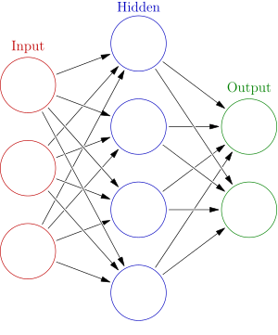
Machine Learning Algorithms
Artificial Neural Network
Neural Networks
Support both supervised and unsupervised learning, able to detect new patterns
Captures complicated relationship, more accurate results faster and more efficiently
Source: https://en.wikipedia.org/wiki/Artificial_neural_network

Slide 7
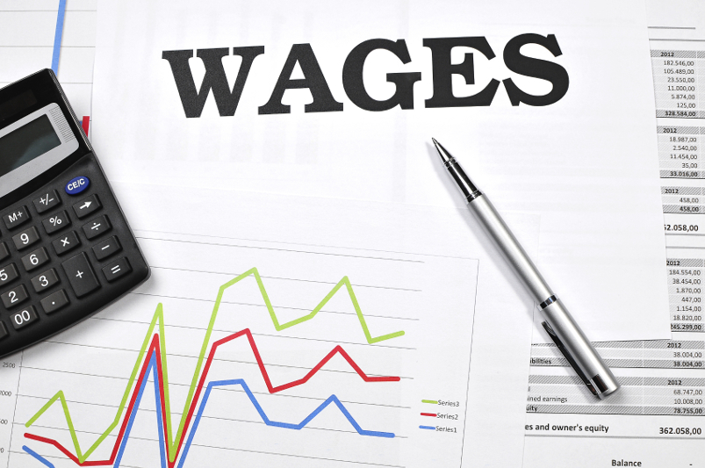

Business Need For Wal-Mart – Real Time Payment
Real Time Payment
Pay employee wages on demand
Pay suppliers immediately to take the early pay discounts
Improve employee satisfaction and reduce costs

Slide 8






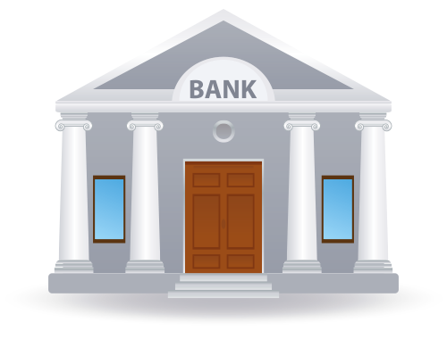

Real Time Payment System
Payment Request
Recipients
Payment Order
Payment Received
Payment Order
Walmart’s Bank

Slide 9

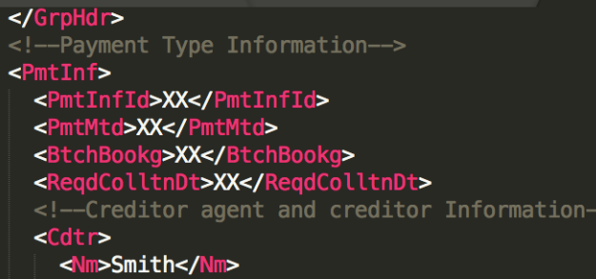
Payment Order – ISO 20022
ISO 20022 Messages
Structured and standard xml based format
Flexible character length and types
Rich resources of toolsets
ISO 20022 Payment order
ISO 20022 Payment order
Walmart’s Bank
Supplier’s Bank

Slide 10
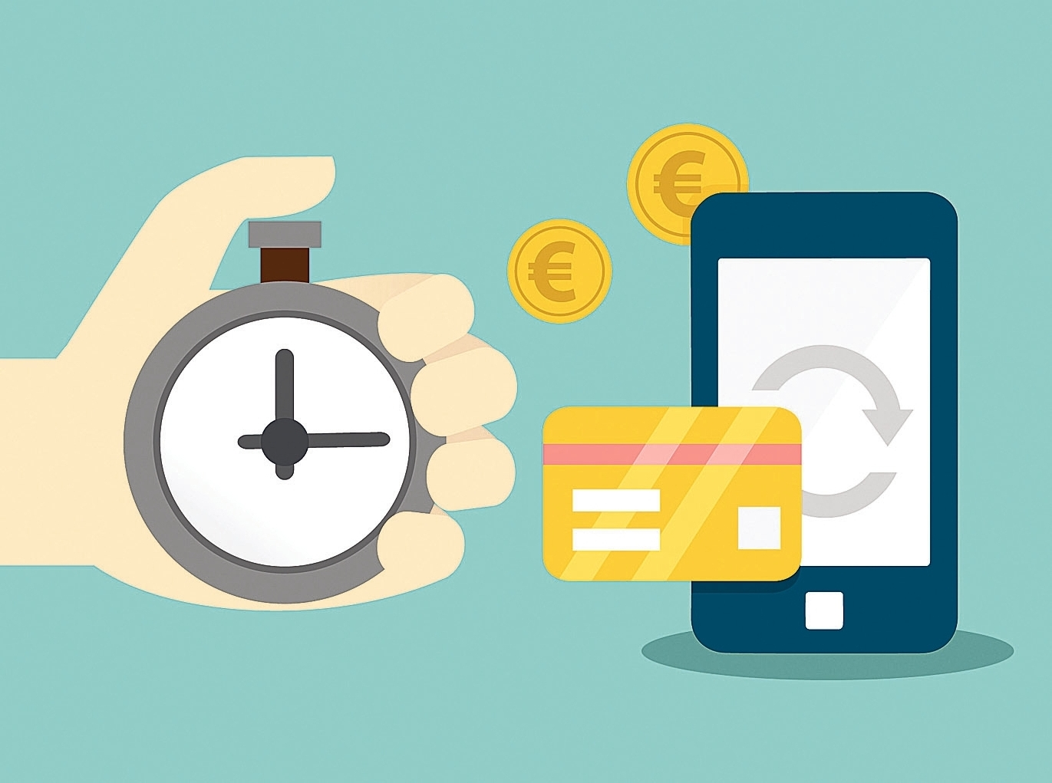

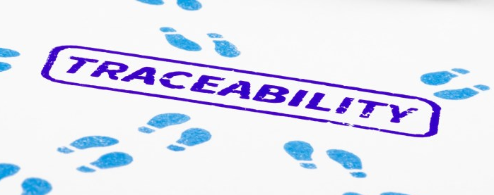
Instant Payment Network – SWIFT GPI
Speed
Trust network among banks.
Banks credit recipients before receiving money from senders.
No limitations
No limitation on number of transactions and amount per transaction.
Traceability
Unique number assigned to each transaction to record the status.
Source: https://www.swift.com/our-solutions/global-financial-messaging/payments-cash-management/swift-gpi

Slide 11
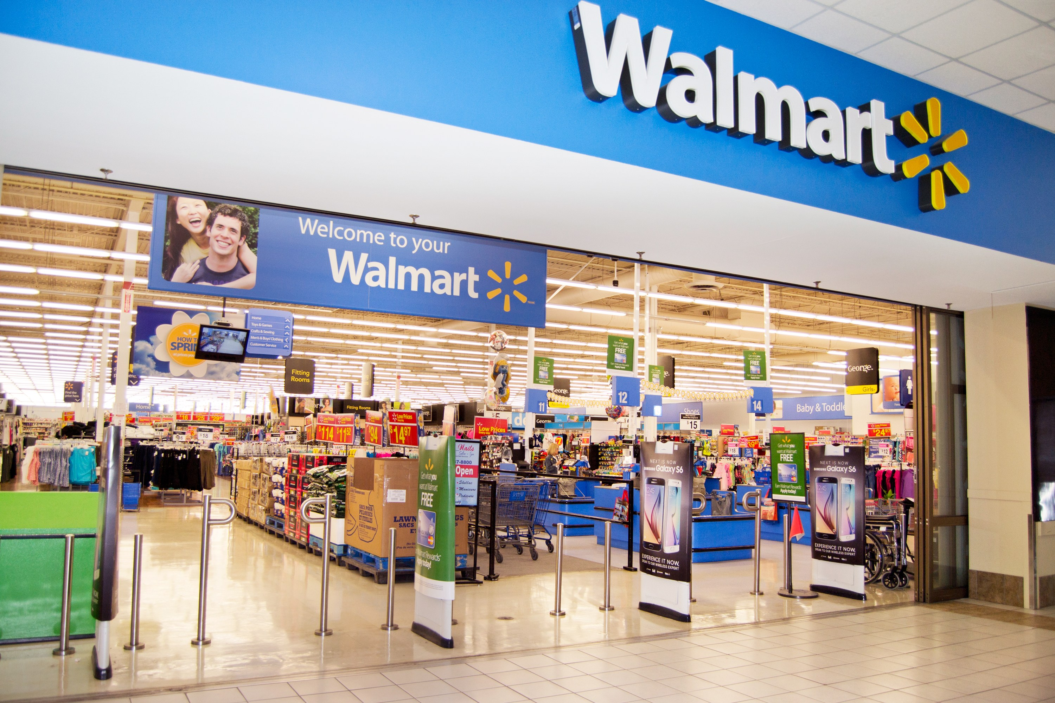
THANKS ! Any Questions?
Team 5
Presented by: Joanna Qiu

